Slide 1
A Brief Introduction to Reinforcement Learning in Medicine
MMCi Block 6
Matthew Engelhard
Notes:
NEED INFO ABOUT ROC, CONFUSION MATRIX, ETC HERE

Slide 2



Slide 3
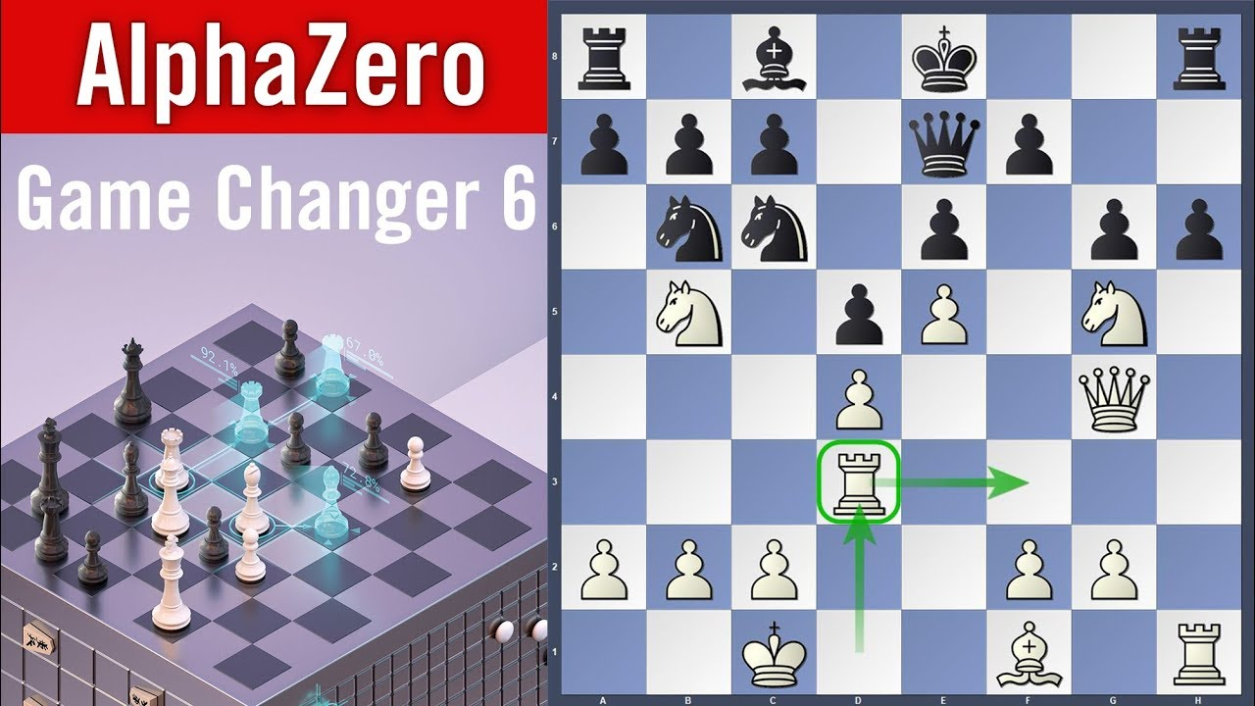
Sequential Decision-Making
Make a series of decisions
based on a set of features (state)
to maximize reward over time
Notes:
examples: robot navigating
Computer program playing video game
Doctor deciding on treatment(s)
Two things to note:
- this is happening on an ongoing basis
- Reward must be quantified numerically

Slide 4
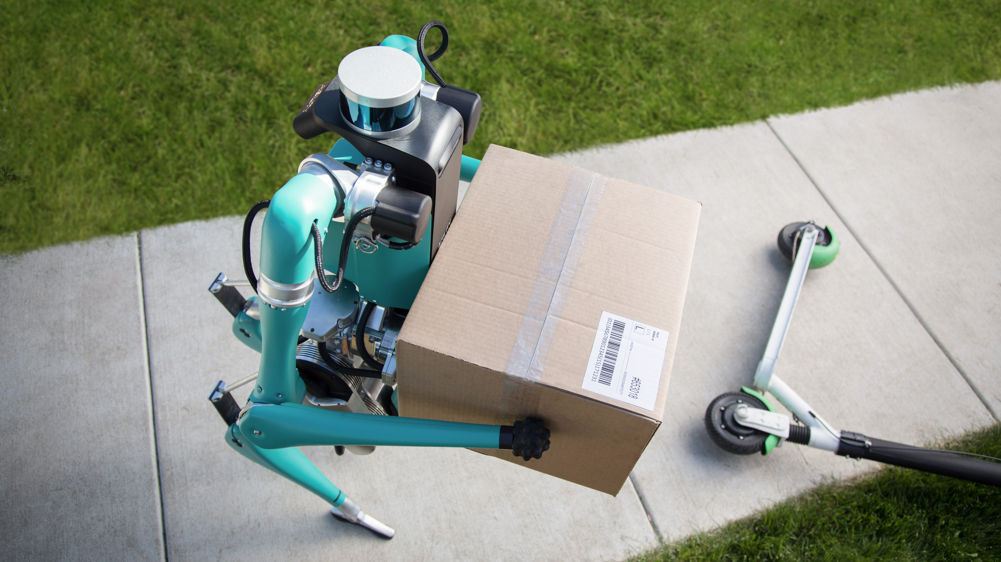
Sequential Decision-Making
Make a series of decisions
based on a set of features (state)
to maximize reward over time
https://www.techradar.com/news/fords-robot-postman-will-deliver-packages-to-your-front-door
Notes:
examples: robot navigating
Computer program playing video game
Doctor deciding on treatment(s)
Two things to note:
- this is happening on an ongoing basis
- Reward must be quantified numerically

Slide 5
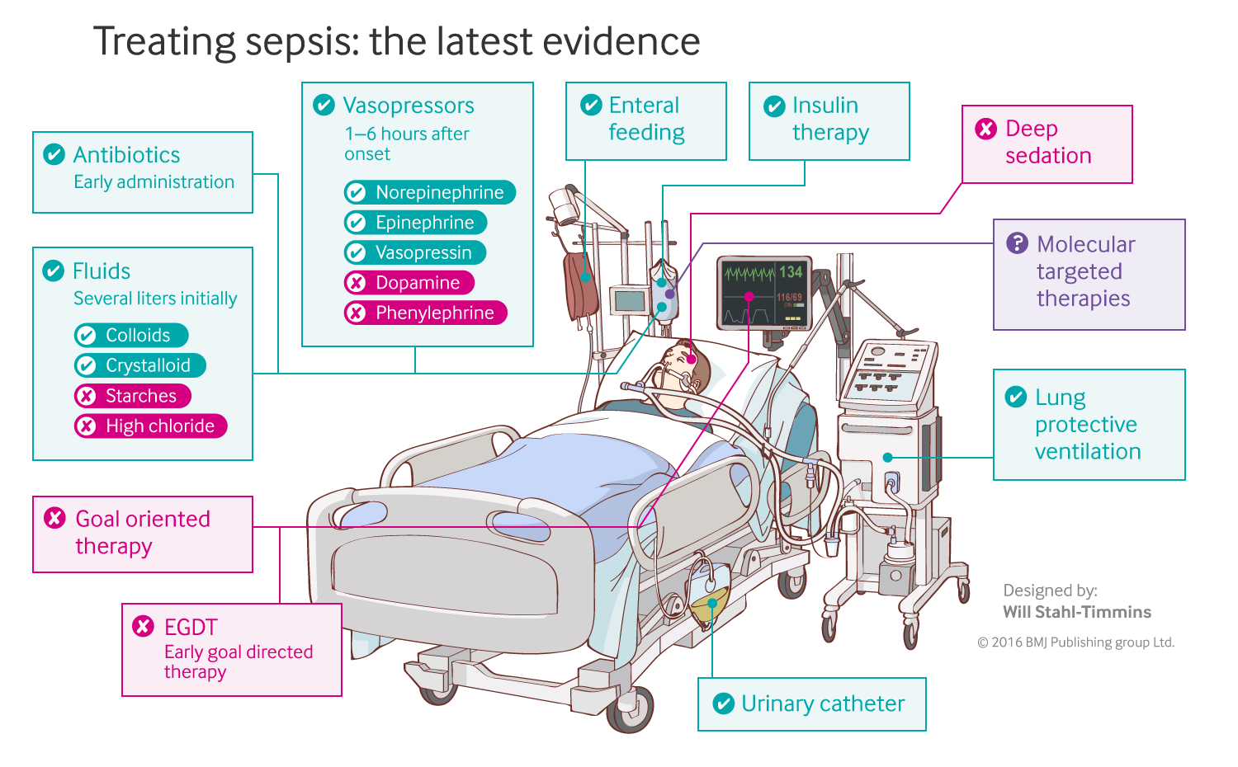
Sequential Medical Decision-Making
Make a series of decisions
based on a set of features (state)
to maximize reward over time
Notes:
examples: robot navigating
Computer program playing video game
Doctor deciding on treatment(s)
Two things to note:
- this is happening on an ongoing basis
- Reward must be quantified numerically

Slide 6
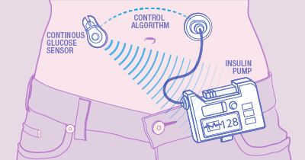
Sequential Medical Decision-Making
Make a series of decisions
based on a set of features (state)
to maximize reward over time
Notes:
examples: robot navigating
Computer program playing video game
Doctor deciding on treatment(s)
Two things to note:
- this is happening on an ongoing basis
- Reward must be quantified numerically

Slide 7
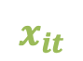
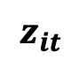
Similarities to models we’ve discussed
softmax
p(advance pawn a)
Make a series of decisions
based on a set of features (state)
to maximize reward over time
p(knight a move 1)
p(castle)
$$x_{it}$$
p(rook b forward 3)
$$z_{it}$$

Slide 8
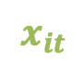
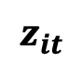
Similarities to models we’ve discussed
softmax
p(give vasopressor amount a)
Make a series of decisions
based on a set of features (state)
to maximize reward over time
p(give vasopressor amount b)
p(give fluid amount a)
$$x_{it}$$
p(give fluid amount b)
$$z_{it}$$

Slide 9
Big difference: we can’t directly evaluate our actions
Instead, we try things and see what works over the long-term
Learn how our actions change the features/state, and keep track
Try to move the system to a “good” state”
softmax
p(give vasopressor amount a)
p(give vasopressor amount b)
p(give fluid amount a)
$$x_{it}$$
p(give fluid amount b)
$$z_{it}$$

Slide 10
What effect do our decisions have on the
patient’s physiologic status?
What if we give vasopressor?
What if we give fluid?
Notes:
examples: robot navigating
Computer program playing video game
Doctor deciding on treatment(s)
Two things to note:
- this is happening on an ongoing basis
- Reward must be quantified numerically

Slide 11
How do changes in physiologic status, influenced by our decisions, affect the patient’s mortality risk?
Effect of actions on the features/state
Value/reward for specific state/decision combinations
Low lactose -> reward
Survival -> high reward
Notes:
examples: robot navigating
Computer program playing video game
Doctor deciding on treatment(s)
Two things to note:
- this is happening on an ongoing basis
- Reward must be quantified numerically

Slide 12
“Uncertainties still exist regarding the optimal type of fluid, the optimal volume, and the best way to monitor the response to therapy.”
Gotts JE, Matthay MA. Sepsis: pathophysiology and clinical management. bmj. 2016 May 23;353(i1585).
Notes:
SOFA: sequential organ failure assessment
Traditional Approach:
central venous pressure (8-12 mm Hg)
mean arterial pressure (65-90 mm Hg)
urine output (0.5 mL/kg/h)
EGDT added:
central venous oxygen saturation (70% target in early goal directed therapy)

Slide 13
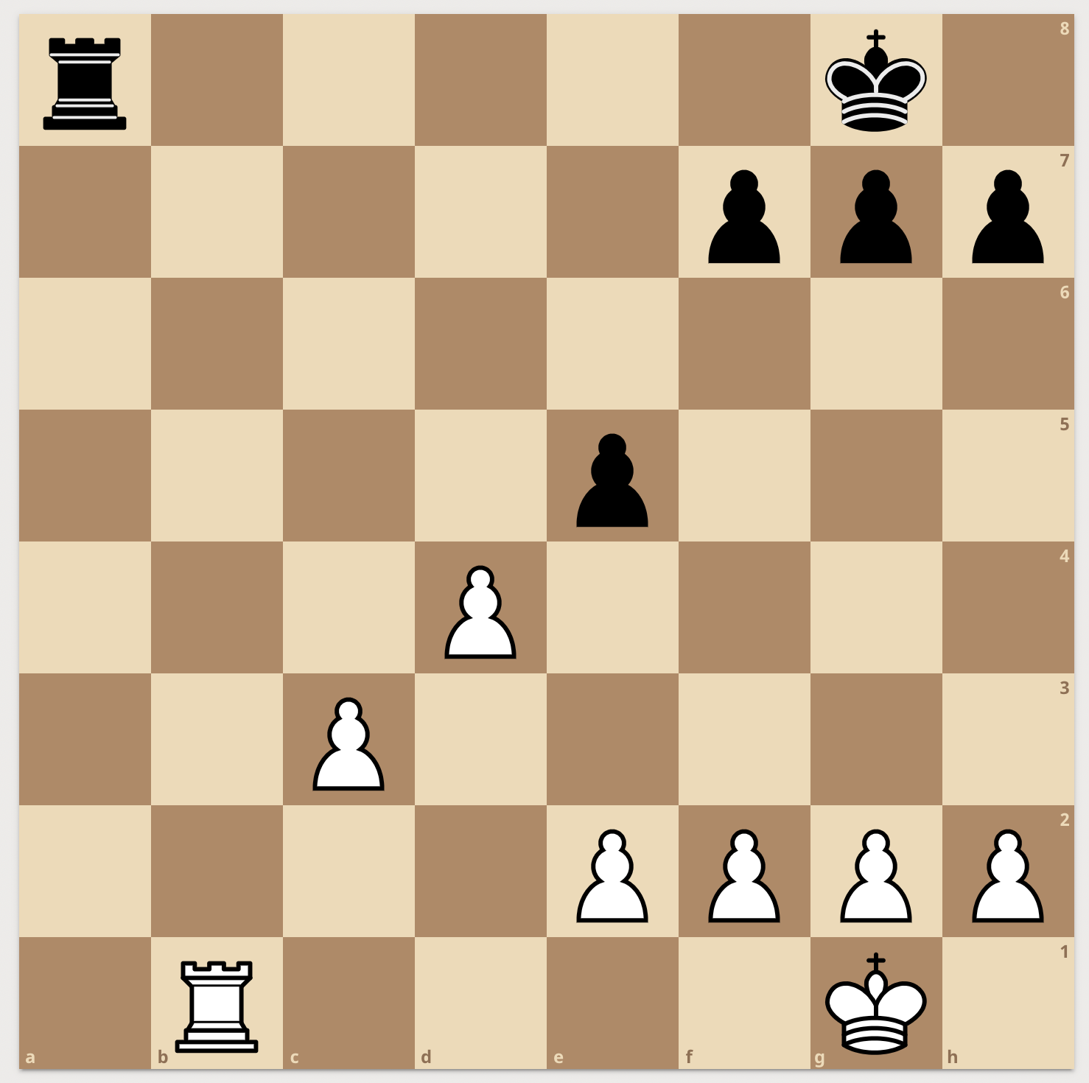
Is this a safe position for black?

Slide 14
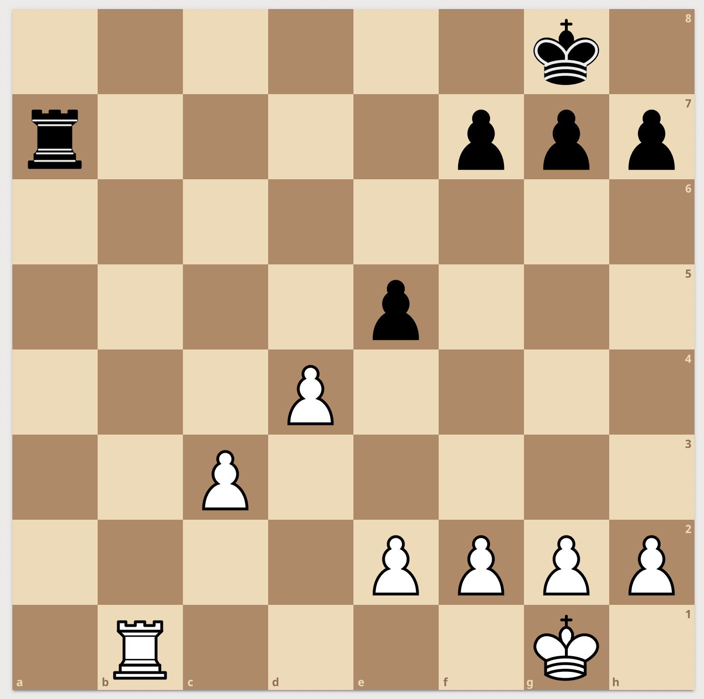
Is this a safe position for black?
RL agent steers the patient toward a ‘safe’ physiologic status: one that tends not to lead to mortality

Slide 15
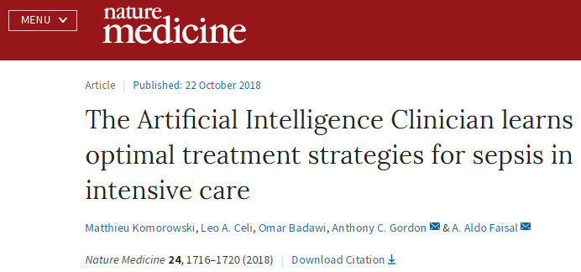
Deep Reinforcement Learning for Sepsis Treatment
Raghu A, Komorowski M, Ahmed I, Celi L, Szolovits P, Ghassemi M.
arXiv:1711.09602. 2017 Nov 27
Policy via Deep Q-Learning
17,898 patients from MIMIC-III
Independent validation on the Philips eICU Research Institute Database:
>3.3 million admissions from 2003–2016 in 459 ICUs across the US
Notes:
The Medical Information Mart for Intensive Care version III (MIMIC-III)
5 min in

Slide 16
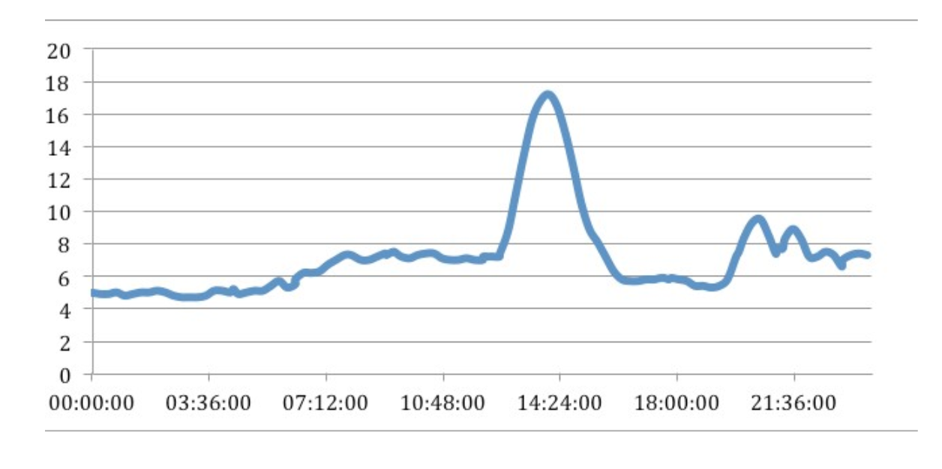
Closed-Loop Blood Glucose Control (artificial pancreas)
Blood Glucose Readings from Continuous Glucose Monitor
mmol/L
https://medium.com/@justin_d_lawler/continuous-glucose-monitoring-the-first-four-weeks-7a6aa5fdb06e

Slide 17
https://www.mayo.edu/research/labs/artificial-pancreas/overview
Sequential Medical Decision-Making:
Artificial Pancreas
How does an insulin bolus affect blood glucose?
It’s complicated… depends on physical activity, general health, meals, individual physiology, etc
Goal: maintain normoglycemia
Additional complication: delayed effect of actions
Notes:
Note that this is happening on an ongoing basis

Slide 18
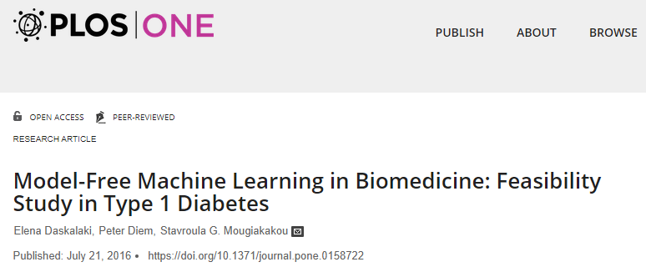

Slide 19
RL’s edge:
keep track of everything
Clinician goals: keep the patient stable.
central venous pressure (8-12 mm Hg)
mean arterial pressure (65-90 mm Hg)
urine output (0.5 mL/kg/h)
central venous oxygen saturation (70%)
RL goals: optimize the outcome
prevent death
prevent organ damage
-> The RL algorithm chooses actions that maximize expected reward over time
Gotts JE, Matthay MA. Sepsis: pathophysiology and clinical management. bmj. 2016 May 23;353(i1585).
Notes:
SOFA: sequential organ failure assessment
Traditional Approach:
central venous pressure (8-12 mm Hg)
mean arterial pressure (65-90 mm Hg)
urine output (0.5 mL/kg/h)
EGDT added:
central venous oxygen saturation (70% target in early goal directed therapy)

Slide 20
What information (features) is important?
Challenge 1 for RL in Health…

Slide 21
Chess or Go: the features (state) are what you see on the board
Notes:
Very clear how to define the state.
Clear set of information that is relevant to decision-making, and we’re able to observe all of it
Less so in medicine
Moreover, what’s on the board right now is the only thing that matters
Doesn’t matter how we got here – has no impact on the best decision going forward
Not always the case in medicine
So there are these two related questions.
What information is important to my decision-making?
What information do I have access to?

Slide 22

Features $xt$: Artificial Pancreas
Blood Glucose Readings from Continuous Glucose Monitor
Idea 1:
The feature is the current blood glucose value
mmol/L
https://medium.com/@justin_d_lawler/continuous-glucose-monitoring-the-first-four-weeks-7a6aa5fdb06e
Notes:
Mention unobserved variables here

Slide 23
Features $xt$: Artificial Pancreas
Blood Glucose Readings from Continuous Glucose Monitor
Idea 2:
The features are the current blood glucose value plus recent trends
mmol/L
https://medium.com/@justin_d_lawler/continuous-glucose-monitoring-the-first-four-weeks-7a6aa5fdb06e
Notes:
Mention unobserved variables here

Slide 24
Features $xt$: Artificial Pancreas
Blood Glucose Readings from Continuous Glucose Monitor
Idea 3:
The features are the current blood glucose value, recent trends, and the patient’s insulin sensitivity
mmol/L
https://medium.com/@justin_d_lawler/continuous-glucose-monitoring-the-first-four-weeks-7a6aa5fdb06e
Notes:
Mention unobserved variables here

Slide 25
Features $xt$: Artificial Pancreas
Blood Glucose Readings from Continuous Glucose Monitor
The features: all information relevant to our decision
BG trends
Previous insulin doses
Patient physiology
Recent behaviors (e.g. eating, physical activity)
mmol/L
https://medium.com/@justin_d_lawler/continuous-glucose-monitoring-the-first-four-weeks-7a6aa5fdb06e
Notes:
Mention unobserved variables here

Slide 26
Features $xt$: Artificial Pancreas
Blood Glucose Readings from Continuous Glucose Monitor
Why is this critical?
Because we’re making many decisions over time, each of which affects the system, errors are compounded when there is unmeasured information that affects system evolution over time
mmol/L
https://medium.com/@justin_d_lawler/continuous-glucose-monitoring-the-first-four-weeks-7a6aa5fdb06e
Notes:
Mention unobserved variables here

Slide 27



We have to choose, explicitly, what the goal should be.
Challenge 2 for RL in Health…

Slide 28
The cost of error is high.
Challenge 3 for RL in Health…

Slide 29
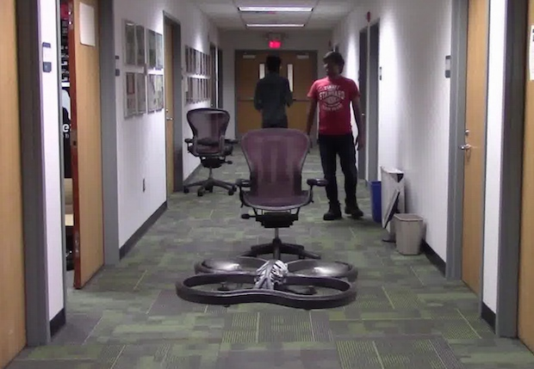
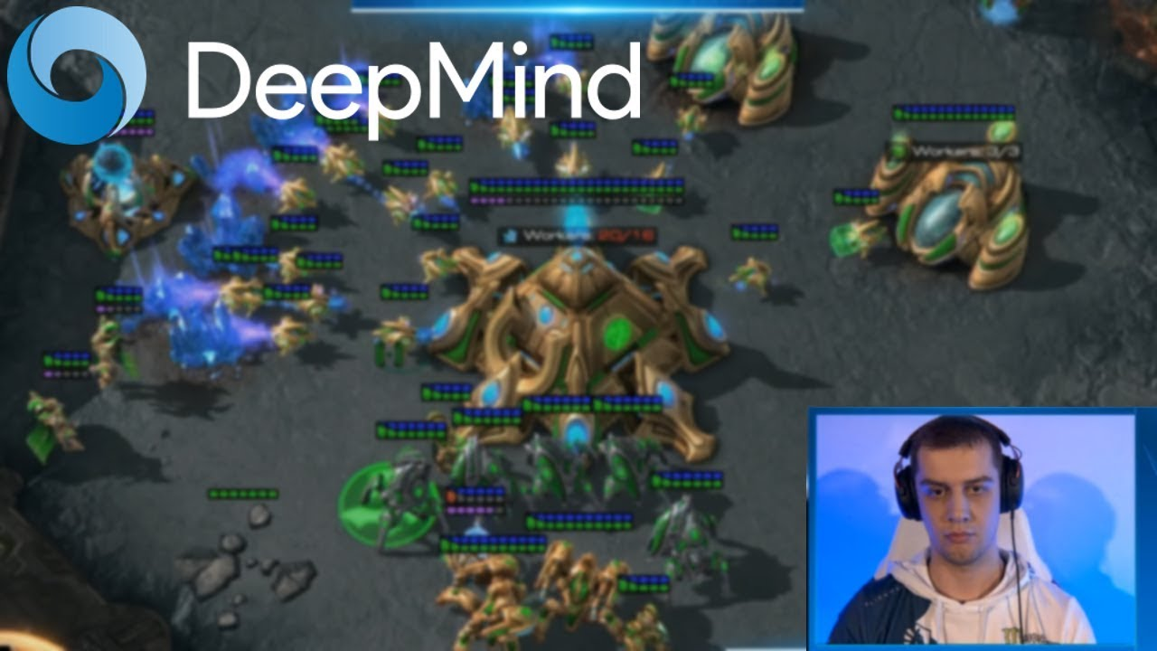
In RL, we typically learn “from scratch”:
Try things and see what works
Initially our actions are random
Drone Uses AI and 11,500 Crashes to Learn How to Fly
Crashing into objects has taught this drone to fly autonomously, by learning what not to do
By Evan Ackerman

Slide 30
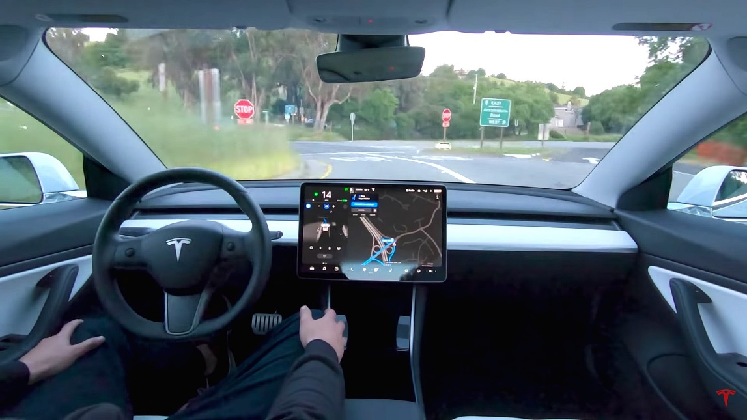
Failing 11,500 times isn’t always an option
-> What are the alternatives?

Slide 31


A1. Learn from Observational Data
The eICU Collaborative Research Database, a freely available multi-center database for critical care research. Pollard TJ, Johnson AEW, Raffa JD, Celi LA, Mark RG and Badawi O. Scientific Data (2018).
provides a large number of (state, action, reward) examples
Notes:
Have a dataset that gives us a large number of {state, action, reward} tuples. Keep updating our Q table or DNN based on these tuples until things converge
It’s as if we’re trying the actions, but the actions we’re able to try are set in advance. So the limitation here is that we can’t explore freely. We may not have any examples of particular actions from a given state, and so their value is unknown to us.
Limitation 1: can’t comprehensively explore
Limitation 2: since the agent is not actually making decisions, there may be confounding variables that are affecting actions that we don’t understand.
Explain how we do this. We simply keep iterating
Cannot control which actions are taken
Tie this back to comments from before

Slide 32
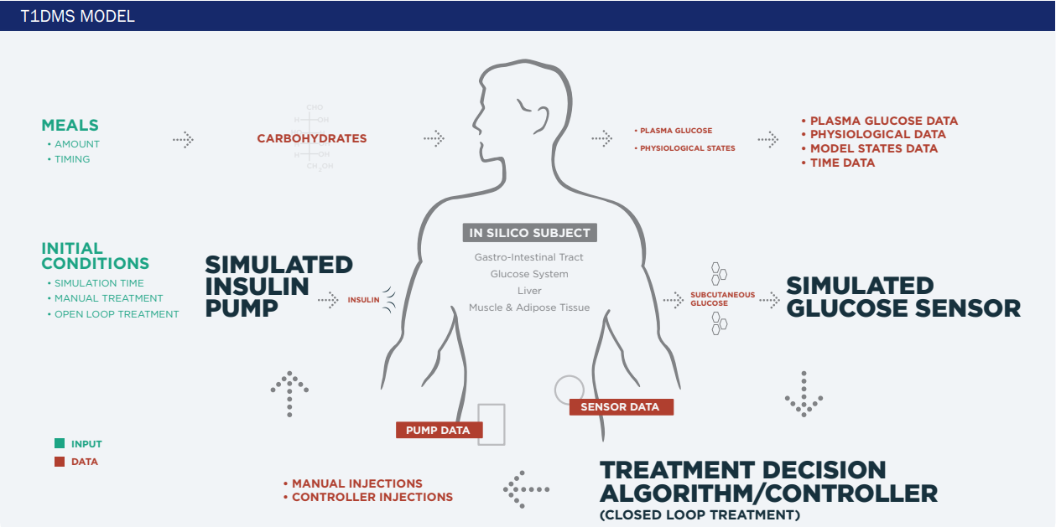
A2. Learn Policy from Simulated Environment
state
Reinforcement Learning Agent
actions
Notes:
State transitions may not match reality
Requires a good existing understanding of how actions influence the state
But, the simulator could be generated using whatever means, and may incorporate physiologic info, for example
So at UVA we have a differential equation based model, includes info about different compartments, long history of development, etc.

Slide 33

A3. Learn with Expert Oversight
physiologic state
algorithm recommendation
physician approval
Notes:
Did this at UVA
Endocrinologist in the loop
- high cost (e.g. clinician time)
- may prevent algorithm from learning a better policy

Slide 34
Open Questions for RL
How can we incorporate existing knowledge to avoid “starting from scratch”?
Should we avoid starting from scratch?
Notes:
More parallels to self-driving cars

Slide 35
Other Directions in RL for Medicine
Clinical Trials and Self-Experimentation

Slide 36
Sequential Decision-Making Problems
are Everywhere in Medicine
A reinforcement learning approach to weaning of mechanical ventilation in intensive care units.
Prasad, Niranjani, et al.
arXiv:1704.06300 (2017).
Notes:
Here we define the full RL problem – again the state is patient physiology, actions are ventilator settings, etc.
Transition – but, is there something even more fundamental?

Slide 37
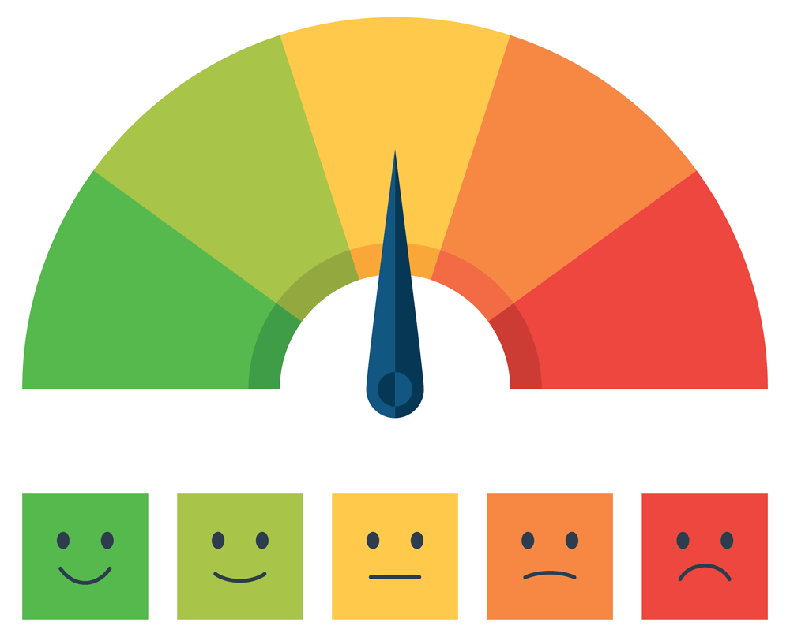
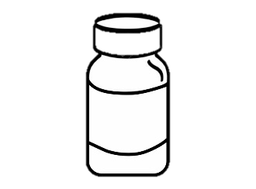
Suppose we are evaluating a new drug…
D
P
P
D
D
Notes:
Here we define the full RL problem – again the state is patient physiology, actions are ventilator settings, etc.
Transition – but, is there something even more fundamental?

Slide 38
A special case of RL
reward
actions
D
P
P
D
D
state??

Slide 39
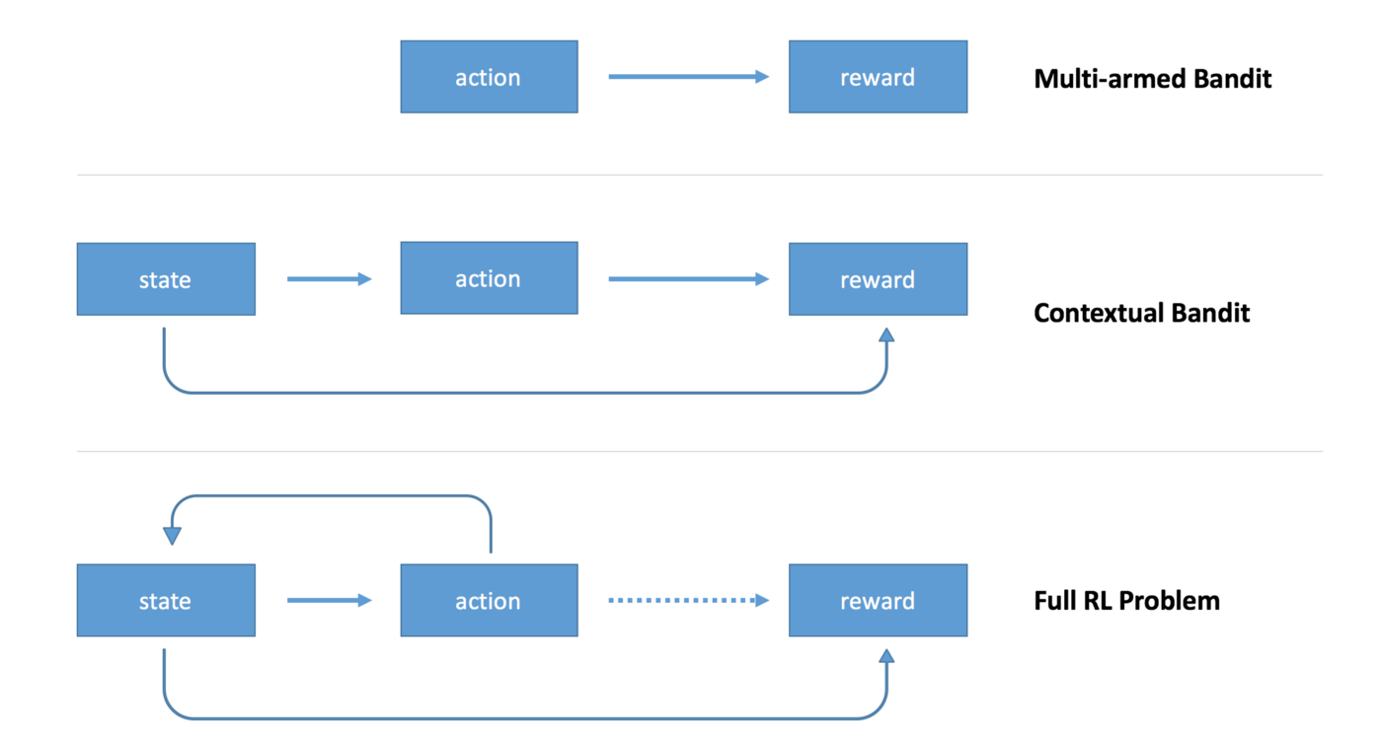
Application: Optimal Allocation of Clinical Trial Participants
“An explicit assumption is the goal to treat patients effectively, in the trial as well as out. That is controversial (…)”
(Stangl, Inoue and Irony, 2012)
Notes:
Challenges:
Modifications to meet frequentist trial design requirements (e.g. maintain higher degree of exploration to control type-I error rate)
Time delay between allocation and result
Deterministic allocation can make the trial more vulnerable to bias (e.g. participant drift, manipulation by a sponsor)

Slide 40
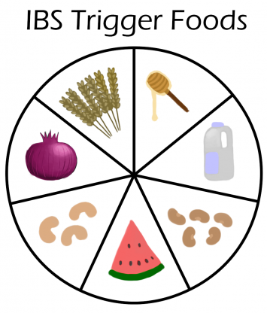
N-of-1 Trial: Identify IBS Triggers
Find foods (i.e. “actions”) that minimize IBS symptoms (i.e. “reward”)
TummyTrials: A Feasibility Study of Using Self-Experimentation to Detect Individualized Food Triggers.
Karkar R, Schroeder J, Epstein DA, et al.
SIGCHI Conference 2017;2017:6850-6863.

Slide 41
This time, we track what works for men versus women
D
P
P
D
D
Notes:
Here we define the full RL problem – again the state is patient physiology, actions are ventilator settings, etc.
Transition – but, is there something even more fundamental?

Slide 42
Personalized clinical trials can be formulated as RL
reward
actions
D
P
P
D
D
state
Notes:
Here we define the full RL problem – again the state is patient physiology, actions are ventilator settings, etc.
Transition – but, is there something even more fundamental?

Slide 43
From https://medium.com/emergent-future/
Notes:
Other example of contextual bandit – what encouragement works best for physical activity
Give one other example

